Slide 1
vFabric Cloud Application Platform
Spring, tcServer and Hyperic - Build , Run & Manage J2EE web apps
Pronam Chatterjee
Notes:
Are you tired of the cost, complexity and deployment inflexibility of heavyweight J2EE platforms?
Does your organization make extensive use of Apache Tomcat Server?
Are you looking for a way to extend Tomcat usage into production environments?
Join us for this webcast led by VMware® and SpringSource outlining the unique elements of the SpringSource tc Server that make it the choice for developers along with providing the operational management, advanced diagnostics and mission critical support capabilities business needs.
In this presentation you'll learn:
Why organizations are moving to more lightweight application servers
Critical steps to move from open source Tomcat to enterprise Tomcat
How lightweight platforms simplify the pathway to cloud deployment

Slide 2
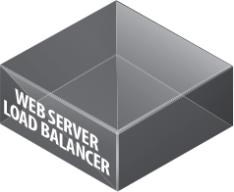
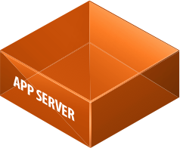
VMware vFabric Cloud Application Platform
vFabric
The ideal application platform environment to run and manage your custom, Java applications – in the datacenter, virtualized environment, or the cloud.
Messaging
Data Management
Notes:
SpringSource Application Platform
The ideal application platform environment to run and manage your custom, Java applications – in the datacenter, virtualized environment, or the cloud.

Slide 3
Development in early 2000s
EJBs
Complexity
Entity beans
Distributed nature
Proprietary Extensions
Development Environments
Unwieldy
Startup times
Difficult to debug

Slide 4
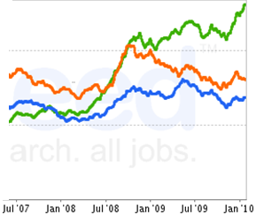
Spring arrives
“
At least 2 million Java developers have some level of proficiency with Spring Core, and this represents at least 50% of enterprise Java developers
Spring
”
Websphere
WebLogic
“
A majority of [enterprise Java] users interviewed by Forrester use Spring
”
“
Half say the adoption of Spring has reduced the time to complete a project by more than 25%, and one in four have reduced the time by over 50%
Source: Indeed.com Job Trends, Feb 2010
”
Notes:
http://www.indeed.com/jobtrends?q=websphere+and+java+and+developer%2C+weblogic+and+java+and+developer%2C+spring+and+java+and+developer&l=
Gartner: Spring: Past, Present and Future, 15 June 2009
Evans Data Corporation, Spring Usage Study, November 2008

Slide 5
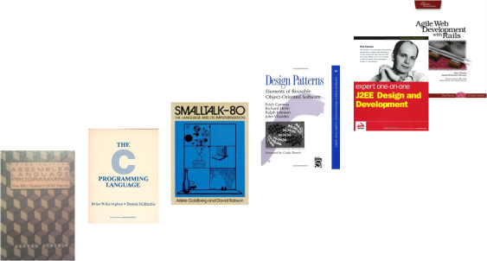
What is new for apps?
New Frameworks
Developer productivity through increasing abstraction
New Domains
Enterprise applications now concerned with mobile, social interactions, SaaS integration
New Data Types, Requirements and Tools
Data growing at 60% per year, NoSQL data solutions, need elastic data
New Infrastructures
Virtualized, Cloud
Public alternatives for app construction
Abstraction
Time
Notes:
First we need to discuss: “What do we mean by New Applications? What is new about applications and why does that mean we need a cloud application platform?”
[CLICK] First, applications today are almost always written to high level frameworks, such as the Spring Framework for Enterprise Java or Ruby-on-Rails for Web applications. These frameworks have made developers more efficient and productive. From the perspective of a developer, in many ways the framework IS the platform. As the frameworks continue to evolve, it is essential that the technology underneath that actually runs the applications, keeps up and we make sure that the efficiency gained for the developer when writing the code is not then lost when deploying and running the app.
[CLICK] Second, even developers building relatively traditional enterprise applications are finding themselves facing new requirements related the emergence of new devices, particularly mobile devices, and a need to integrate with new, Web-based services such as social networks or SaaS applications.
[CLICK] Third, applications today are generating far more data – and many more types of data – than ever before. The traditional idea that all data goes into a (standard relational) database simply no longer applies given the data volumes, the increasingly real-time nature of applications, and the desire for elastic scale . Certainly, web giants like Google, Amazon and Facebook have innovated aggressively in new data management technologies and there is an explosion of new open source projects focused on caching or ‘NoSQL’ data solutions.
[CLICK] Finally, as we at VMware know very well, the world of infrastructure is entirely different today from even five years ago. Today, the infrastructure is virtual and dynamic, sometimes on-premise and sometimes remote, and new ideas are emerging for infrastructure-as-a-service and platform-as-a-service. Clearly, we need to consider whether the application runtime and data management approaches designed ten and twenty years ago for large, static servers in secured, private datacenters are still the best choices today.

Slide 6
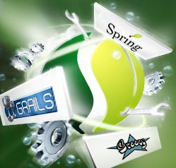
STS - Developer Efficiency
SpringSource Tool Suite
Spring Roo
Grails
Spring
(Core, Rich Web, Integration)
Java
Groovy
tc Server
(Spring Insight)
Agile Development - Integrated Testing
Tight integration with tc Server minimizes application redeploys/restarts
Links performance issues to code traces highlighted in Spring Insight
Supports flexible deployment targets
tc Server, Java EE servers, VMware, Cloud, etc.
Notes:
SpringSource Tool Suite (STS) provides the best way for a developer to get started with Spring or Grails.
Since it embeds the developer edition of tc Server, developers get the benefits of using the Spring Insight performance dashboard which automatically instrucments their existing Spring applications and provides deep insight into Spring application performance.
STS provides a rich set of visual tools, wizards, code generation tools and tutorials that help a developer create applications very quickly.
STS enables developers to deploy their applications onto any Java application server (tc Server, WebLogic, etc), deploy into VMware Workstation and VMware Lab Manager environments, and deploy into cloud platforms such as Cloud Foundry. The key point here is that we provide c consistent developer experience no matter what the deployment target may be (developer desktop, data center, or cloud)

Slide 7
Tomcat is a Proven Standard
WebLogic
26%
Spring Applications
JBoss
38%
WebSphere
43%
Apache Tomcat
68%
0%
10%
20%
30%
40%
50%
60%
70%
Java Application Server Usage, Source: 2008 Evans Data Survey
“
The adoption of Tomcat reflects the Java developers' preference for lighter, simpler technologies
”
Notes:
As mentioned previously, Spring powers 50% of the applications running on WebSphere, WebLogic, and Tomcat.
The widespread use of Spring alleviates the need for many of the services in heavyweight J2EE application servers such as IBM WebSphere and Oracle (BEA) WebLogic, however, and Apache Tomcat rose in popularity at the same time as Spring due to some of the same value propositions.
This has led to Tomcat being the most widely used Java application server on the market. Note that the %’s on the chart don’t add up to 100% since most enterprises deploy two or more Java application servers. Tomcat is by far the most widely deployed.
SpringSource provides tc Server, an enterprise version of Tomcat that delivers the efficiency and control enterprises need for widely deploying lightweight platforms. Since SpringSource employs the key open source leaders driving the majority of feature enhancements and bug fixes for Tomcat, we are uniquely positioned to deliver this value to the market.
SpringSource is driving this shift to lightweight platforms because it is the best path to achieving new levels of efficiency and flexibility for our customers.
Deploying a lightweight platform running on virtualized infrastructure provides the ultimate flexibility and agility as our customers plot their course towards cloud computing.
What Benefits can be obtained by embracing a lightweight platform?
- Simpler Installation and Provisioning: 20X Smaller Install Footprint: Less than 50MB vs. multi-Gigabytes
- Simpler Configuration and Deployment: Lower complexity across Dev, QA, Staging, Production
- Efficient Resource Utilization: Less application infrastructure = More flexibility for your applications
- Easier Upgrade and Migration: Less infrastructure = Lower complexity = Faster migration / upgrade
- Developer Productivity: Lightweight platforms support agile development methodologies
Tc Server is enabling the path to cloud for such customers as Fidelity, EMC, Associated Newspapers, etc.

Slide 8
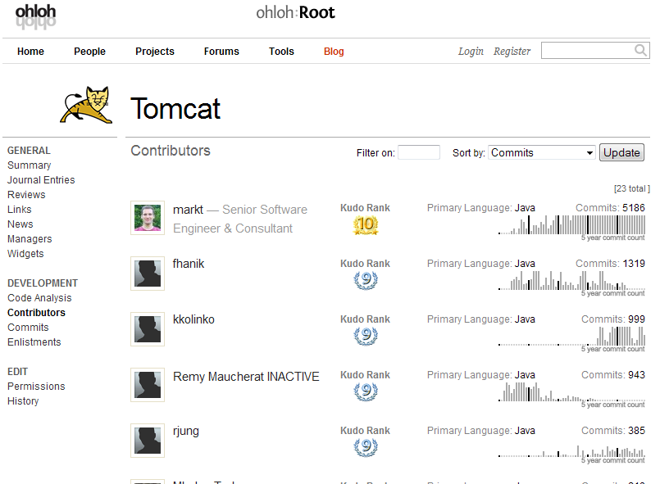
Leadership and Expertise
Notes:
Support from Experts
Over 80% of Tomcat commits
Over 95% security/bug patches
98.5% Annual Support Renewal Rate

Slide 9
Operational Control: Enhanced Tomcat Server
Apache Tomcat 7
Enterprise Capabilities
Servlet 3.0(JSR 315)
Java Server Pages 2.2 (JSR 245)
Side by Side deployment
Memory Leak Prevention and Detection
Protection against Session fixation attacks
Load balancing
Advanced I/O Features
Improvements in Memory Usage
Stable, Fast, Lightweight
Run multiple instances per install
Centralizes tc Server install/updates
Enterprise-ready stable release
Security vulnerabilities & bug fixes
Fixes will be in upstream open source release
Built, certified and pre-tuned
Advanced Scalability Options
Non-blocking (NIO) connectors
High concurrency connection pool
Advanced Diagnostics
Detects deadlocks and slow running requests
Provides access to SQL behind slow requests
Identifies time spent in garbage collection
Notes:
tc Server also enhances its Tomcat compatible core with advanced diagnostics. For example, tc Server supports request level diagnostics that detect slow running requests and identifies the time spent during the request in garbage collection and database operations - frequent causes of slow requests. The diagnostics for database operations provide access to the SQL that triggered the slow request making root cause analysis significantly simpler.

Slide 10
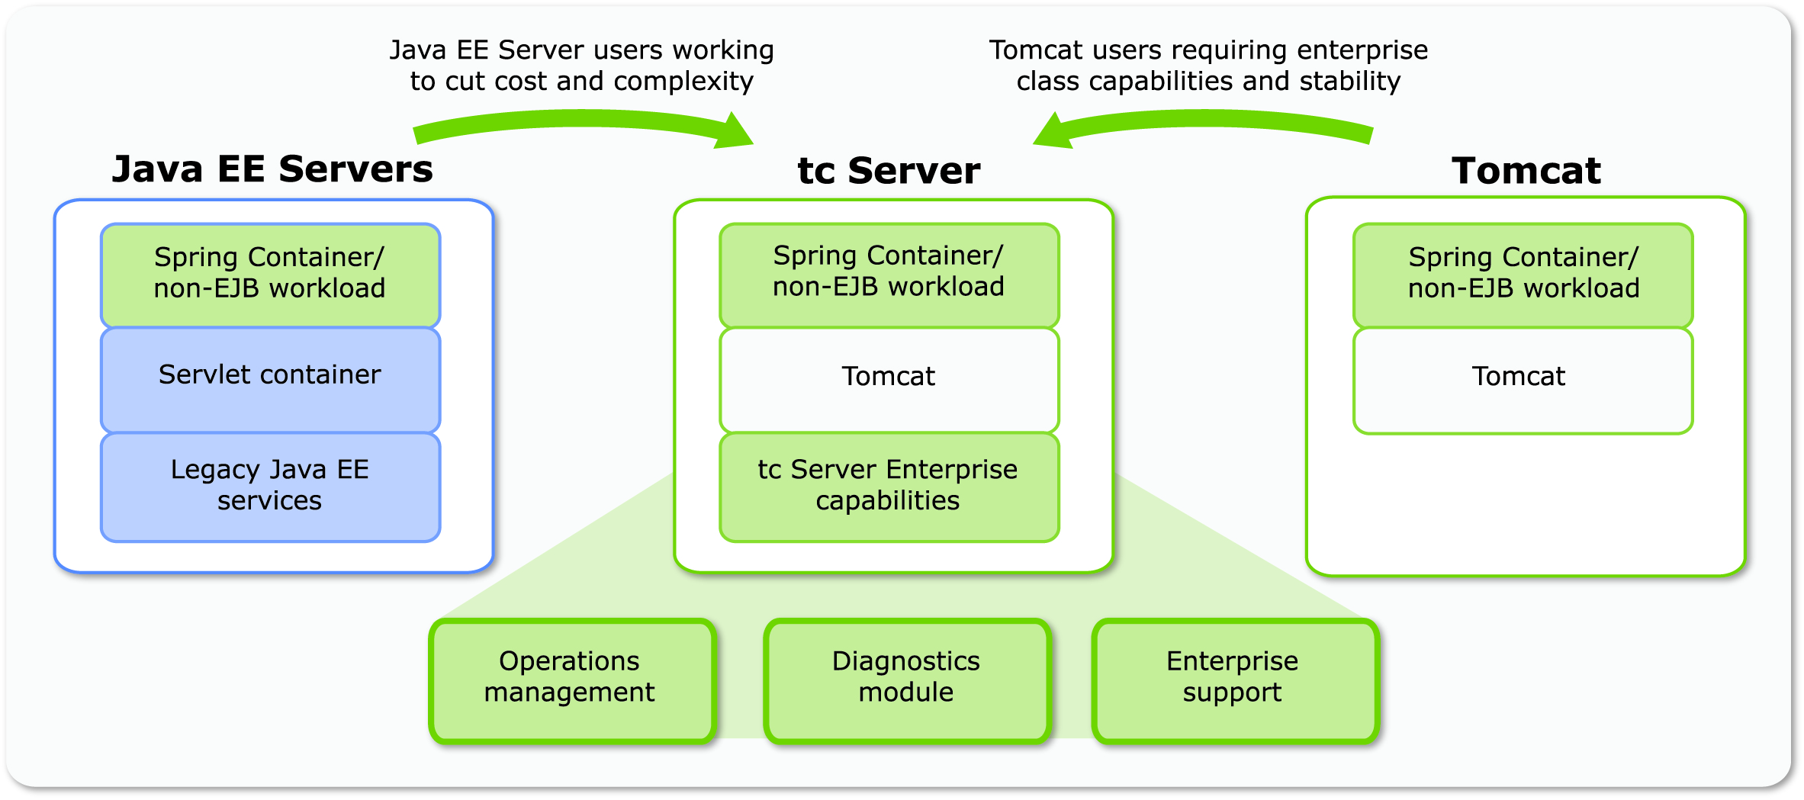
tc Server Fills the Gap
Notes:
Efficient, lean, fit-to-purpose runtime platform
Lower cost and complexity
Enterprise capabilities on Tomcat-compatible base
Great platform to run Spring & Grails applications
===
SpringSource tc Server is an enterprise version of Tomcat that provides the operational capabilities that operations needs while preserving the lightweight footprint of Tomcat that developers love.
Tc Server provides an efficient, lean, fit to purpose runtime platform that enables customers to achieve much lower cost and complexity.
It provides a great platform to run Spring applications as well as standard non-EJB Java web applications.
Tc Server is ideal for those who are already widely using Tomcat today but need the operational management capabilities that Tomcat does not provide today.
It is also a great platform for running Spring applications that are running on other platforms such as WebLogic or WebSphere and doing so with significantly less cost and complexity.

Slide 11
vFabric tc Server: Key Highlights
Familiar Spring + Tomcat experience
Deep performance insight into Spring apps
Agile Spring development experience via STS
Developer
Efficiency
Performance & SLA management of Spring apps
Application provisioning and server administration
Rich alert definition, workflows, and control actions
Group availability & event dashboards
Secure unidirectional agent communications
Operational
Control
Lean server (10 MB) ideal for virtual environments
Template-driven server instance creation
Integrated experience with VMware environments
Open, secure API for all operations
Deployment
Flexibility

Slide 12
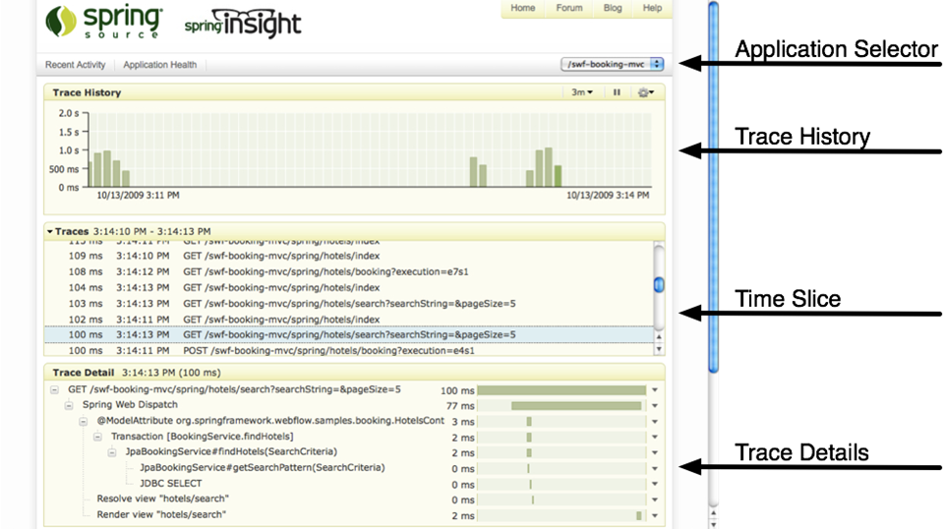
Developer Efficiency: Deep Performance Insight into Spring Apps

Slide 13
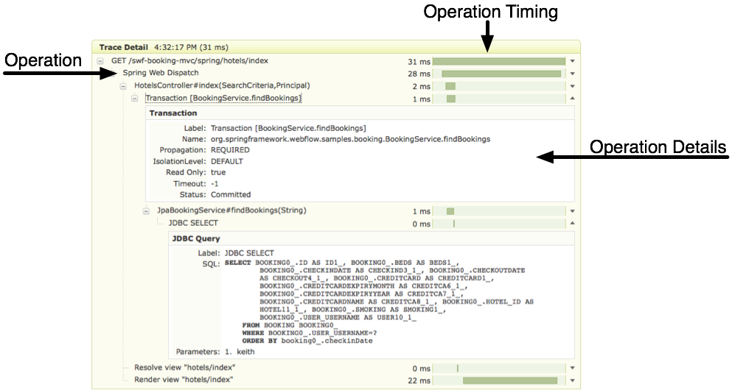
Developer Efficiency: Deep Performance Insight into Spring Apps

Slide 14
vFabric tc Server: Key Highlights
Familiar Spring + Tomcat experience
Deep performance insight into Spring apps
Agile Spring development experience via STS
Developer
Efficiency
Performance & SLA management of Spring apps
Application provisioning and server administration
Rich alert definition, workflows, and control actions
Group availability & event dashboards
Secure unidirectional agent communications
Operational
Control
Lean server (10 MB) ideal for virtual environments
Template-driven server instance creation
Integrated experience with VMware environments
Open, secure API for all operations
Deployment
Flexibility

Slide 15
Monitoring Architecture
Server 1
Management Server
Administration, Provisioning, Groups, Metrics, Alerts, Events, Access Control, Agent Upgrades, etc.
Web
Dashboard
tc Server
Instance 1
tc Server
Instance 1
tc Server
Instance 1
Spring
Agent
Open API
Server 2
Server 1
Inventory, Metric, Audit, …
tc Server
Instance 1
Seamlessly Upgradeable
tc Server
Instance 1
tc Server
Instance 1
tc Server
Instance 1
tc Server
Instance 1
tc Server
Instance 1
Spring
Agent
Agent
Hyperic Monitoring
Web Servers, App Servers, Databases, Caching, Messaging, Directories, Virtualization, etc.
Spring
Spring
Spring
Notes:
http://static.springsource.com/projects/tc-server/6.0/getstart/cgscreateinst.html#cgscreateinst__templates
Create multiple instances of tc Server with a single set of binaries. This adds the following value for customers:
A single installation of tc Server (that uses the SpringSource layout) supports multiple running tc Server instances.
One set of binaries means easy upgrades of all the associated instances.
Multiple separate instances allows testing of configuration and code changes without touching the production instance.

Slide 16
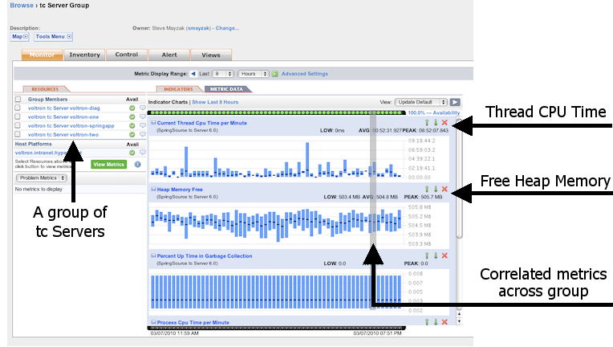
Monitor: VM, OS, JVM, tcRuntime Container…
Monitor Application Server Status, Health, and Response Times
Availability, Session Count, Throughput, Utilization, Connection & Thread Pool Health, Deadlock Detection, Garbage Collection
Notes:
Automatically monitors execution times for code that uses @Controller, @Service, @Component, @Transactional, and @Repository stereotyped annotations:
Metrics: AverageElapsedExecutionTime(ms), ExecutionsPerSecond, InvocationCount, MaximumExecutionTime(ms), MinimumExecutionTime(ms), ThrownExceptionCount
NOTE: @Controller, @Service, and @Component are typically key endpoints within an application worth measuring, and @Repository and @Transactional handle data access and transaction management, both of which are worth measuring. People using these Spring annotations get these metrics collected automatically (no extra work on their part).
We also monitor execution times and enable operations to be executed across a range of standard Spring components such as:
Platform Transaction Manager:
Metrics: CommitsPerSecond, FailedCommits, FailedResumes, FailedRollbacks, FailedSuspends, ResumesPerSecond, RollbacksPerSecond, SuspendsPerSecond
Hibernate Session Factory has over 40 metrics exposed including:
Metrics: QueryExecutionMaxTime(ms), QueryExecutionCount, QueryCacheHitCount, QueryCacheMissCount, EntityLoadCount, EntityInsertCount, , EntityUpdateCount, EntityDeleteCount, …
Default Message Listener Container:
Metrics: ActiveConsumers, AverageElapsedTimePerMessage(ms), FailedMessages, MessagesPerSecond, MessagesReceived, ScheduledConsumers
Operations: start, stop, set Concurrent Consumers, set Max Concurrent Consumers, scale Max Concurrent Consumers, set Max Messages Per Task, set Idle Task Execution Limit
JMS Template:
Metrics: AverageElapsedTimePerMessageSent(ms), FailedMessageSends, MessagesSent, MessagesSentPerSecond
Operations: set Receive Timeout
Java Mail Sender:
Metrics: AverageElapsedTimePerMessage(ms), FailedMessages, MessagesSent, MessagesPerSecond
Operations: setHost, setPort
Thread Pool Task Executor:
Metrics: ActiveTasks, LargestPoolSize, PoolSize, QueueSize
Operations: set Core Pool Size, set Max Pool Size, set Keep Alive Seconds

Slide 17
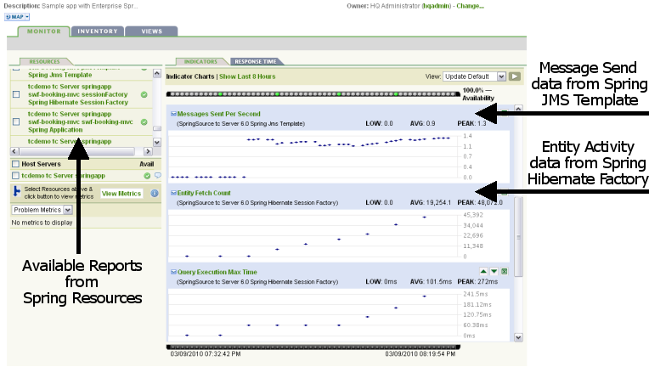
Monitor (cont’d): Spring Framework at Runtime, your JMX Java
Automatically Monitor Application, Data Access, Custom Components
@Controller, @Service, @Component, @Transactional, @Repository, @ManagedResource
Executions Per Second, Average Execution Time, Maximum Time, Minimum Time, etc.
Monitor Performance and Execute Control Operations inside Spring
Transaction Manager, Hibernate Session, Message Listener, JMS, JavaMail, Thread Pool, etc.
Start/Stop Listener, Set Max Messages, Set Receive Timeout, Set Pool Size, Set Keep Alive, etc.
Notes:
Automatically monitors execution times for code that uses @Controller, @Service, @Component, @Transactional, and @Repository stereotyped annotations:
Metrics: AverageElapsedExecutionTime(ms), ExecutionsPerSecond, InvocationCount, MaximumExecutionTime(ms), MinimumExecutionTime(ms), ThrownExceptionCount
NOTE: @Controller, @Service, and @Component are typically key endpoints within an application worth measuring, and @Repository and @Transactional handle data access and transaction management, both of which are worth measuring. People using these Spring annotations get these metrics collected automatically (no extra work on their part).
We also monitor execution times and enable operations to be executed across a range of standard Spring components such as:
Platform Transaction Manager:
Metrics: CommitsPerSecond, FailedCommits, FailedResumes, FailedRollbacks, FailedSuspends, ResumesPerSecond, RollbacksPerSecond, SuspendsPerSecond
Hibernate Session Factory has over 40 metrics exposed including:
Metrics: QueryExecutionMaxTime(ms), QueryExecutionCount, QueryCacheHitCount, QueryCacheMissCount, EntityLoadCount, EntityInsertCount, , EntityUpdateCount, EntityDeleteCount, …
Default Message Listener Container:
Metrics: ActiveConsumers, AverageElapsedTimePerMessage(ms), FailedMessages, MessagesPerSecond, MessagesReceived, ScheduledConsumers
Operations: start, stop, set Concurrent Consumers, set Max Concurrent Consumers, scale Max Concurrent Consumers, set Max Messages Per Task, set Idle Task Execution Limit
JMS Template:
Metrics: AverageElapsedTimePerMessageSent(ms), FailedMessageSends, MessagesSent, MessagesSentPerSecond
Operations: set Receive Timeout
Java Mail Sender:
Metrics: AverageElapsedTimePerMessage(ms), FailedMessages, MessagesSent, MessagesPerSecond
Operations: setHost, setPort
Thread Pool Task Executor:
Metrics: ActiveTasks, LargestPoolSize, PoolSize, QueueSize
Operations: set Core Pool Size, set Max Pool Size, set Keep Alive Seconds

Slide 18
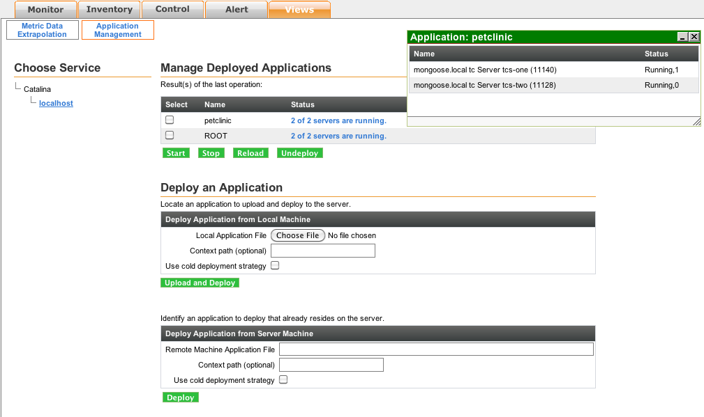
Manage: Application Updates
Push WARs to groups, hot or cold
Manage deployed applications
View session counts
Start, stop, reload, and undeploy applications

Slide 19
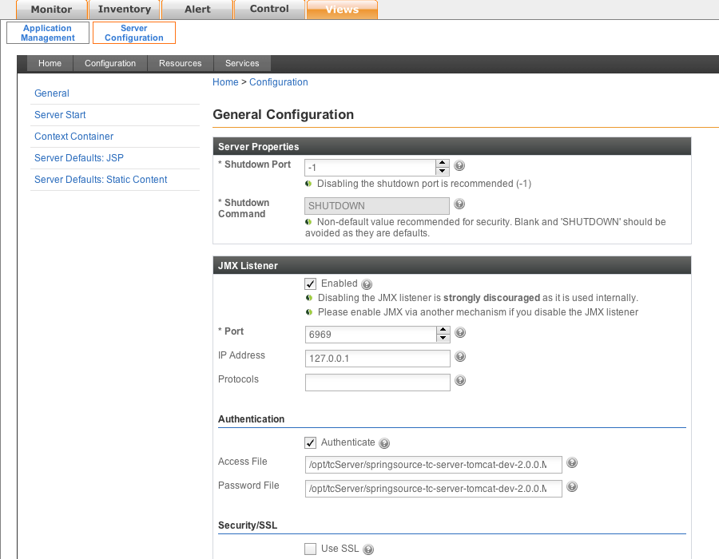
Manage: Administration & Configuration
JVM parameters, Engines, Hosts, Contexts, Data Sources, Connectors
Via Web GUI or Command-Line interface

Slide 20
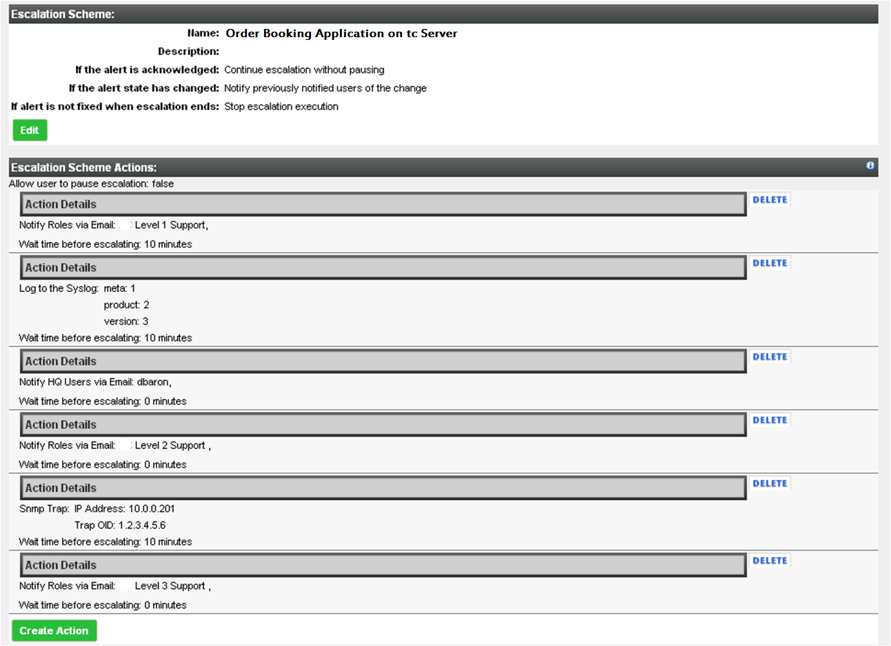
Manage: Alert Workflows and Automated Control Actions

Slide 21
Optimized Memory Management when Running on vSphere
Example VMware Labs Effort
vSphere-integrated Java memory management
Leverage ESX memory management features to overcome limitations of Java’s static heap
ESX and tc Server cooperate to recover memory when the JVM does not need it and supply more when JVM is under memory pressure
Major increase in efficiency without risking Java out-of-memory errors
Application
tc Server
Elastic Memory
JVM
vSphere (ESX)
NOTE: This slide covers features that are under development and subject to change.

Slide 22
Operational Control: tc Server Spring Edition Demonstration
vFabric tc Server
Demonstration

Slide 23
vFabric tc Server: Key Highlights
Familiar Spring + Tomcat experience
Deep performance insight into Spring apps
Agile Spring development experience via STS
Developer
Efficiency
Performance & SLA management of Spring apps
Application provisioning and server administration
Rich alert definition, workflows, and control actions
Group availability & event dashboards
Secure unidirectional agent communications
Operational
Control
Lean server (10 MB) ideal for virtual environments
Template-driven server instance creation
Integrated experience with VMware environments
Open, secure API for all operations
Deployment
Flexibility

Slide 24
Deployment Flexibility: tc Server Instances (virtualized platform)
Medium Virtual Machine
tc Server
Instance 1
tc Server
Instance m
. . .
Small VM
Small VM
Spring
Spring
Spring
Spring
tc Server
(shared binaries)
tc Server
tc Server
Operating System & JVM
OS & JVM
OS & JVM
Virtual Infrastructure Platform
Complete flexibility to deploy large, medium, and small “machines”
Lightweight footprint ensures maximum resource utilization
Notes:
http://static.springsource.com/projects/tc-server/6.0/getstart/cgscreateinst.html#cgscreateinst__templates
Create multiple instances of tc Server with a single set of binaries. This adds the following value for customers:
A single installation of tc Server (that uses the SpringSource layout) supports multiple running tc Server instances.
One set of binaries means easy upgrades of all the associated instances.
Multiple separate instances allows testing of configuration and code changes without touching the production instance.

Slide 25
Deployment Flexibility: Distribute or Combine
tc Server
Instance 1
tc Server
Instance m
tc Server
Instance X
. . .
Spring
Spring
Spring
Spring
Spring
tc Server ver X
(shared binaries)
. . .
tc Server ver Y
(shared binaries)
Operating System & JVM
Notes:
http://static.springsource.com/projects/tc-server/6.0/getstart/cgscreateinst.html#cgscreateinst__templates
Create multiple instances of tc Server with a single set of binaries. This adds the following value for customers:
A single installation of tc Server (that uses the SpringSource layout) supports multiple running tc Server instances.
One set of binaries means easy upgrades of all the associated instances.
Multiple separate instances allows testing of configuration and code changes without touching the production instance.
Single lightweight (10MB) install for multiple running instances
Shared binaries eases upgrades of all instances
Separates configuration and code from server runtime
Multiple server versions can be installed per machine

Slide 26
The vFabric GemFire HTTP Session Management Module
HTTP session module for Tomcat and tc Server
Built into the application server kernel
Inside or outside the application server
peer to peer topology

Slide 27
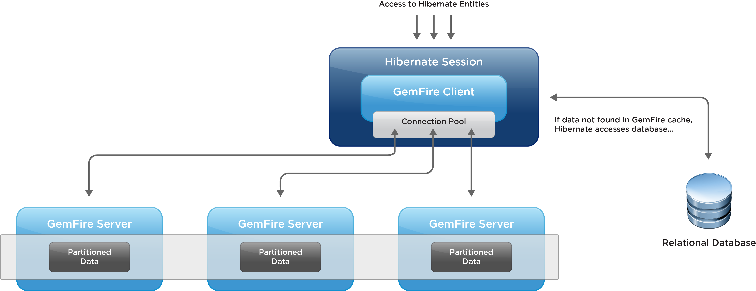
The vFabric GemFire Hibernate Cache Module
Hibernate L2 cache
Built as a Hibernate plugin, no code change
Query results cached in object formats, across nodes

Slide 28
Well beyond ASF Tomcat, yet fully compatible
Full binary app compatibility – Zero lock in
Patch and Update without touching config
Multi-instance Templating
High Concurrency DB Connection Pool w/ JMX
Asynchronous Logging
Dynamic Log Level changes via JMX
Encyption for DB passwords
Improved Windows Service Wrapper
UNIX startup scripts
Pre-Tuned and Secured
Native Session-Replication clustering or GemFire
Built-In Diagnostics Valve
Permgen Error Detection
Notes:
Enterprise ready stable release
Cherry-picked. Tomcat releases with known issues fixed or skipped
Security vulnerabilities fixed and pushed to ASF
Version upgrade not required
Patches backported & provided in binary form
Only patch if applicable
Bugs fixed and pushed to ASF
Backported binary patches for tc Server vs. full version upgrades required for ASF Apache Tomcat
No need to wait for next release
Fixes tested and verified before released
Out-of-Box Advanced Tomcat Configuration
Tuned Production Configuration
Preconfigured Connectors: NIO, APR, SSL
Features not in ASF Tomcat today
Automated Boot Scripts - UNIX
Improved Service Wrapper – Win 32/64
High Concurrency DB Connection Pool
Asynchronous Logging
Runtime Configurable Logging Level
Encrypted DB Passwords

Slide 29
Why Spring and tc Server?
“As we have moved to Spring, which allows our developers to do less work on the infrastructure, we can focus more on the business logic and features that make us competitive.”
— Alex Antonov, Technical Lead, Core Frameworks
Orbitz
“Test and live deployments are taking the developers literally a couple of minutes with tc Server – where they used to take up to two hours on Oracle WebLogic. The throughput on tc Server is at least 3X greater than WebLogic and the CPU and load on the production servers is about half.”
— Shaun Perkinson, Head of Development
Associated Newspapers
Notes:
Orbitz Case Study:
http://www.springsource.com/files/uploads/all/pdf_files/customer/Orbitz%20Case%20Study.pdf
Orbitz Worldwide, based in Chicago, is a leading global online travel company that uses innovative technology to enable leisure and business travelers to research, plan and book a broad range of travel products. Orbitz Worldwide is one of the premier technology organizations in ecommerce today and owns a portfolio of consumer travel brands including: Orbitz, CheapTickets, ebookers, HotelClub, RatesToGo, the Away Network, Asia hotels, and corporate travel brand Orbitz for Business. Orbitz.com receives 6000 hits per second, and 10+ million unique visitors every day.
Associated Newspapers Case Study:
http://www.springsource.com/files/uploads/all/pdf_files/customer/Associated%20Newspapers%20Case%20Study1.pdf
The Digital Services Division (DSD) of Associated Newspapers (ANL) provides all online development and infrastructure services to ANL’s online portfolio of newspaper web sites. This includes the Daily Mail, UK’s largest online newspaper website, as well as Evening Standard, This Is Money, Metro and 150+ regional sites. ANL’s goal is to deliver websites that offer an engaging and satisfying experience for users and measurable commercial benefits to advertisers. ANL is part of the Daily Mail and General Trust plc.
Found on:
http://www.springsource.com/customers/case-studies

Slide 30
Best Container for VMWare
“Without tc Server, I could not have deployed my web-based applications into the internal private cloud environment I created. SpringSource tc Server’s small footprint allows me to deploy a dozen app server instances on one physical box virtualized by VMware, with plenty of capacity left over.”
— Jon Brisbin
NPC International
Notes:
Associated Newspapers Case Study:
http://www.springsource.com/files/uploads/all/pdf_files/customer/Associated%20Newspapers%20Case%20Study1.pdf
Found on:
http://www.springsource.com/customers/case-studies
NPC International operates more than 1,200 Pizza Hut restaurants worldwide, and it has adopted web-based applications for various internal functions, such as payroll, HR operations and invoice approval for purchasing of pizza ingredients and other supplies. The web applications are built using the SpringSource-led Spring Framework, and therefore the transition to tc Server was seamless.

